Slide 1
RISD Financial Aid Exit Counseling
(Federal/Private Loan Considerations)
STUDENT FINANCIAL SERVICES
SPRING 2023

Slide 2
Requirement!
Federal Loan Exit Counseling:
Online program required for all students who borrowed federal loans
Complete Student Loan Exit Counseling
Complete by 6/1
Private Loan Exit Counseling
Each individual lender will have their own requirements. Reach out to them, if you haven’t already, and ensure that you are fully aware of their repayment requirements.
Complete by 6/1

Slide 3
Best Practice Timeline
June 2023
Complete online exit counseling
Check in with your Loan Servicer
Ensure your contact information is correct with your loan servicer
Review loan amounts
Consider your repayment strategy
July 2023
Set a reminder in your phone to check the news for pertinent repayment updates!
Interest on “unsubsidized loans” will likely begin to accrue again
loans currently in repayment? (prior degrees)
October 2023
Prepare for repayment! November likely first payment due
6 month grace period after end of classes 5/17/2023

Slide 4
Rights
•Prior to your repayment, the loan holder is required to provide you with a disclosure statement containing a repayment schedule and information regarding interest rates, fees, balance owed and repayment options.
•You have the right to a grace period. (Federal Direct Student Loan).
•If you qualify, you have the right to defer payments on your loan(s) after the grace period expires (only applies to certain situations) and you have the right to request a forbearance.
•You may prepay the entire sum of your student loan or pay more than the minimum requirement at any time without penalty.
•You have the right to cancellation/discharge if the borrower dies, becomes permanently and totally disabled, is unable to complete a program of study because the school closed, is a victim of forgery, or if a loan is falsely certified by the school.
•The U.S. Department of Education may transfer servicing of your loans. If this occurs, you will receive notification from the current servicer and from the new servicer. http://studentaid.ed.gov/repay-loans/understand/servicers
•Under the Direct Loan Program, you can change repayment plans anytime.

Slide 5
Responsibilities
•The federal Master Promissory Note (MPN) that you signed was your promise to repay the funds. It provides important language about your rights and responsibilities with respect to obtaining and repaying the loan.
•Repay the loan(s) according to the repayment schedule (even if you have not received a bill). Notify the servicer of any circumstance that affects your ability to repay, or to confirm your eligibility for deferment or forbearance.
•Notify the servicer if you have graduated, withdrawn from school, dropped below half-time status, transferred to another institution, and/or changed your name, address, phone number or social security number, or if you fail to enroll for the period covered by the loan(s).
•Complete an exit counseling session before leaving school.
•Repay at least $600 per year ($50 a month, unless you have a deferment, Income Driven Repayment plan, or your lender agrees to a lesser amount).
•Remember that your loan(s) must be repaid even if you do not complete your education, are unable to obtain employment upon completion, or are dissatisfied with the educational program.

Slide 6
In the News!
Student Debt Relief: You may have heard about the student debt relief programs now moving through the courts.
To stay up to date with the court proceedings, bookmark this page:
One-time Federal Student Loan Debt Relief
Potential Impacts:
Up to $10,000 of forgiveness if you borrowed prior to 7/1/2022
Up to $20,000 if you were a Pell grant recipient
Currently being considered by the supreme court, expected decision June of 2023
Payment/Interest Pause: Due to the Covid pandemic a special “forbearance,” where loan repayment and interest accrual were paused on all federal loans, was enacted. COVID-19 Emergency Relief and Federal Student Aid
Quoting: Covid-19 federal emergency relief page
Student Loan Payment Pause Extended
The student loan payment pause is extended until the U.S. Department of Education is permitted to implement the debt relief program or the litigation is resolved. Payments will restart 60 days later. If the debt relief program has not been implemented and the litigation has not been resolved by June 30, 2023 — payments will resume 60 days after that. We will notify borrowers before payments restart.

Slide 7
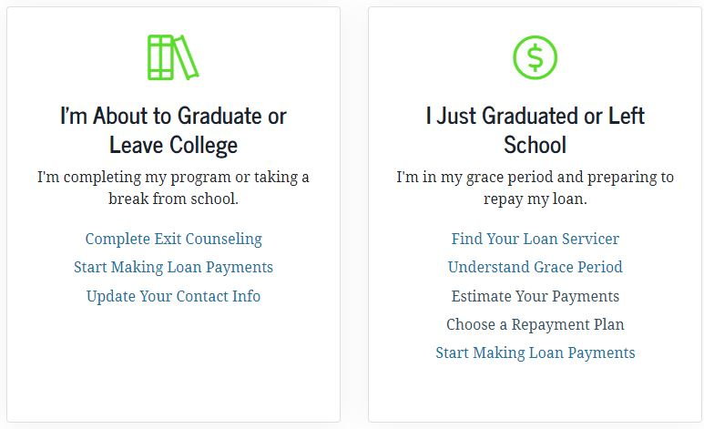
Federal Loan Exit Counseling
Takes about 30 minutes
Requires your FSA ID
https://studentaid.gov/fsa-id/sign-in/landing
Federal website has greatly improved with useful information
You do not finalize your repayment option during this session
https://studentaid.gov/h/manage-loans

Slide 8
Tips for Exit Counseling Website:
Use PC over Mac
Don't use Safari; use Chrome
Clear cache and cookies
Use an incognito window
If there is an invalid graduation date, consider using a current date and pay attention to the format requested.

Slide 9
Your Federal Loans at RISD
Direct to student loans:
Federal Direct Student Loan (2 types)
Subsidized: Interest paid by government
Unsubsidized: Interest accrues while in school and deferment
Fixed interest rate set each year
Parent PLUS/Grad
Paid to parent or Grad student
Unsubsidized: Interest accrues while in school and deferment
Fixed Interest rate set each year
Year | Interest Rate % | Origination Fee %
2017/2018 | 7.00 | 4.2
2018/2019 | 7.595 | 4.2
2019/2020 | 7.079 | 4.2
2020/2021 | 5.3 | 4.2
2021/2022 | 6.28 | 4.2
2022/2023 | 7.54 | 4.2
Year | Interest Rate % | Origination Fee %
2017/2018 | 4.45 | 1.01
2018/2019 | 5.045 | 1.01
2020/2021 | 4.529 | 1.01
2020/2021 | 2.750 | 1.01
2021/2022 | 3.73 | 1.01
2022/2023 | 4.99* | 1.01
Graduate Rate 6.54%
Notes:
Cherry pick which loans to pay (if you have a little extra cash)

Slide 10
How To Find Your Current Loan Information
Your Loan Servicer:
The 9 companies to which the Department of Education has awarded contracts to service your loans.
Examples:
- MOHELA
- Nelnet
- Great Lakes
- ECSI
- EdFinancial
- Aidvantage (former Navient)
National Student Loan Data System
Federal website that contains full accounting of your loan information (review once a year)
https://studentaid.gov

Slide 11
Federal Loan Repayment
Variety of options
No prepayment penalties
Ability to change plans (be careful switching out of income driven repayment; defaults to 10 year plan)
Standard: 10 Years
Extended: 25 Years ($30,000 or more in total fed loan borrowing)
Graduated: Payments start low, and increase over time
Examples:
Gross Amount of Debt | $50,000 | $75,000 | $100,000 | $150,000
Standard (10 year plan) | $555 | $832 | $1,110 | $1,665
Extended (25 year plan) | $322 | $483 | $644 | $965
Payments that exceed 15% of income are generally considered “excessively burdensome” and may not be sustainable

Slide 12
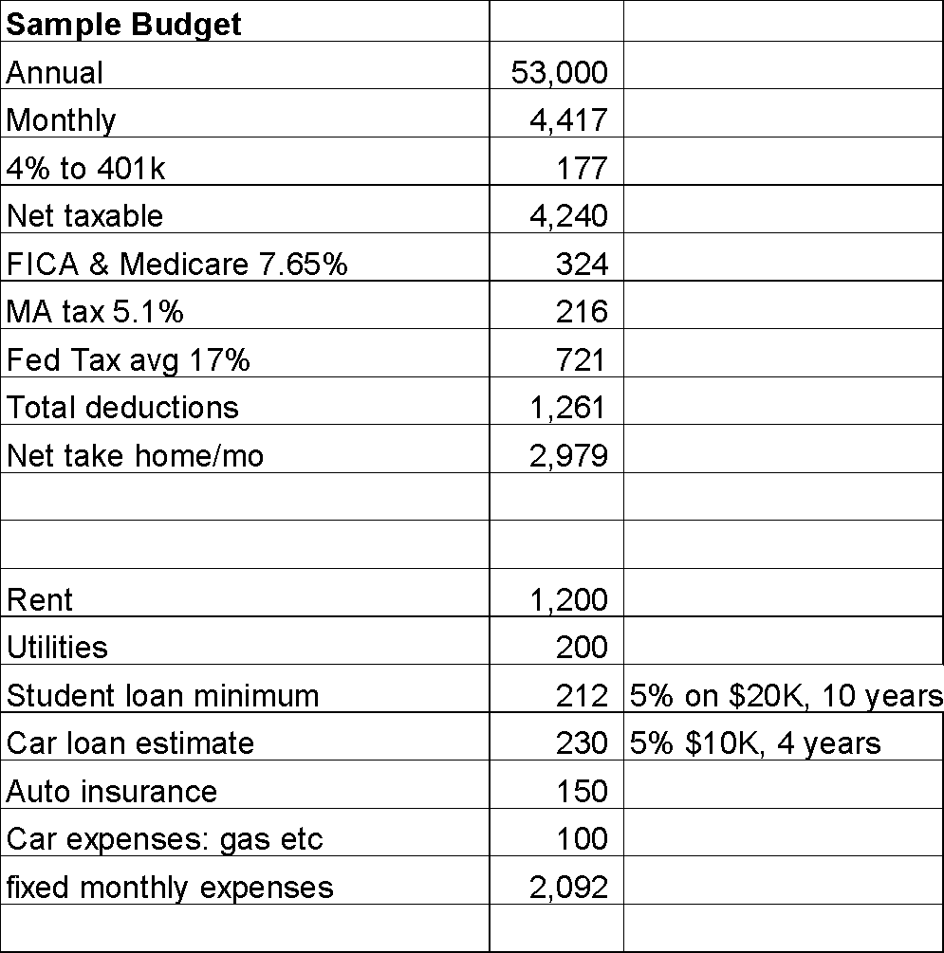
Sample Budget: From Recent Financial Planning Session

Slide 13
Federal Income Driven Repayment
Powerful tool to help make student loan payments affordable.
Income sensitive
Payments based on AGI, not how much you owe
Low required monthly payments likely cause “negative amortization” (what you owe growing faster than payments)
Four plans, but typical graduates currently utilizing REPAYE
REPAYE example:
payment amount is calculated as 10% of the adjusted gross income (AGI) that exceeds 150% of the poverty level
20 years if all loans you’re repaying under the plan were received for undergraduate study;
25 years if any loans you’re repaying under the plan were received for graduate or professional study
Required Monthly Payment (Income based) REPAYE
Adjusted Gross Income (AGI) | Monthly Payment
$40,000 | $175
$60,000 | $340
$80,000 | $507
$100,000 | $675
https://studentaid.gov/manage-loans/repayment/plans/income-driven

Slide 14
Default
Excessive delinquency* on student loan payments. Default if you fail to make your monthly payment for a total of at least 270 days.
Very Serious
entire unpaid balance becomes due
high collection fees
wages garnished/loss of professional license
lien on property
lose eligibility for additional student aid and federal benefits
Very Avoidable!
Stay in contact with your servicer, deferment, forbearance options.
https://studentaid.gov/manage-loans/default
*Delinquency starts after 1 day of late payments; after 30 days = late payment reported to at least one credit bureau.
Notes:
270 missed

Slide 15
Federal Loan Safety Nets
Deferment: required payment pause
In-school (unsubsidized loans continue to accrue interest)
Economic Hardship
Military Service
Forbearance: Payment pause
Up to 3 years total (no more than 12 months at a time)
Requires application
Life event
Future of these options… hard to predict.
https://studentaid.gov/manage-loans/lower-payments/get-temporary-relief/forbearance

Slide 16
Loan Forgiveness
Public Service Loan Forgiveness.
Federal loan forgiveness after 10 years of repayment under qualifying employment and 120 payments (does not need to be consecutive)
Three Requirements:
Qualifying Repayment Plan
Right kind of employment
Remaining Loan Debt
https://studentaid.gov/manage-loans/forgiveness-cancellation/public-service
PSLF Help Tool: https://studentaid.gov/pslf/

Slide 17
Loan Forgivness as a benefit?
Employer Loan Forgiveness Programs:
https://www.wsj.com/articles/companies-pay-down-workers-student-debt-as-supreme-court-weighs-forgiveness-f3ce6be4

Slide 18
Loan Consolidation
Combining federal loans into one new loan, with a weighted average interest rate.
Pros:
Simple way to manage loans
Bring loans together if under $30,000 to take advantage of extended repayment
Interest rate becomes “weighted average of all loans consolidated;” minimal change to interest rates.
Cons:
Interest rate slightly higher (consolidated loan 1/8 % higher rate)
New loan!
If consolidating during your grace period, repayment begins immediately.
Lose benefits from individual loans
https://studentaid.gov/app/launchConsolidation.action

Slide 19
Refinancing
•Convert variable rate loans (if you have them) to a fixed rate loan
•Potentially lock in a lower interest rate (example, higher rate Grad PLUS loan to lower rate private loan)
•Simplify the borrower’s life – one bill/one payment per month
•Receive an interest rate reduction for automatic monthly payments
•Provide for additional borrower benefits
Comparing Refinance Options
•Interest rate – Fixed or variable? Based on credit?
•Fees – What are they? Up front, back end or both? How much will they add to total cost?
•Repayment – How long is the term? What is the monthly payment?
•APR – Is the total cost of borrowing – including accruing interest, capitalized interest and fees - expressed as an annual interest rate? A tool which can be used to compare the total cost of one loan to another.
•What borrower benefits are offered by the lender? What must be done to achieve them?
•Does the loan have different repayment options? Does the loan have an Income-Based Repayment option?
•Is deferment or forbearance available?
•If the student who benefitted from the loan dies or is permanently disabled, is the loan forgiven?

Slide 20
Final Tips
Closely review your monthly budget before deciding on a repayment plan
Set Up Electronic Payment
Set it and forget it
.25% reduction interest rate
https://www.nerdwallet.com/article/loans/student-loans/auto-pay-student-loans
Give yourself some “grace”
68% of graduates from nonprofit colleges had loans in 2016*
Very few students default
* Student Loan Hero, student debt statistics

Slide 21
You Are Not Alone!
We remain a resource for you!
Feel free to continue to contact us as an alum.
https://www.risd.edu/sfs
20 Washington Place, First Floor
401-454-6661
sfs@risd.edu
Office hours: Monday-Friday, 8:30 am-4:30 pm

Slide 22
Federal Ombudsman
Having an issue with your loan servicer? Other loan related issues?
You may contact the Federal Student Aid Ombudsman Office. They are a resource to help you resolve issues that you cannot resolve through your loan servicer.
Phone: 1-877-557-2575
https://studentaid.gov/feedback-ombudsman/disputes/prepare

Slide 23
Resources and Links
Federal Loans
Federal Loan Website:
https://studentaid.gov/understand-aid/types/loans
The Institute of Student Loan Advisors
https://freestudentloanadvice.org/
Financial Planning
Foundation for Financial Planning (probonoplannermatch.org)
Additional Sessions this summer as needed!

